Slide 1



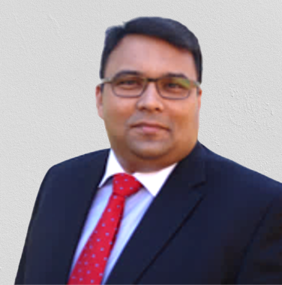
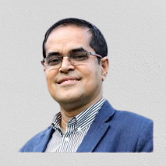





Presents
MEET THE LEADERS: Conversation with NRBs
April 8, 2022
9:30 PM to 10.00 PM
Guest SPEAKER
HOST
DR. EZAZ AHMED
QUAZI M. AHMED
Dean, Business Entrepreneurship & Technology, Columbia College,
South Carolina, USA
Founder & President
BOLD
www.fb.com/WeAreBOLDfamily
Partners:
In collaboration with

Slide 3
